Slide 1
Financial Analytics

Slide 2
Introduction
The analysis focuses on the top 500 companies in India, examining their market capitalization and quarterly sales.
The goal is to provide insights into the competitive landscape and identify key trends and patterns.

Slide 3
Details of Data
The dataset includes market capitalization and quarterly sales data for the top 500 companies in India.
It contains company names, market capitalization, and quarterly sales, and pertains to the most recent available quarter.
Data cleaning was performed to address any missing values and ensure accurate data types.

Slide 4
Main KPIs
Market Capitalization: The total market value of a company’s outstanding shares.
Quarterly Sales: The total revenue generated by a company in a quarter.
Top Performers: Companies with the highest market capitalization and sales.

Slide 5
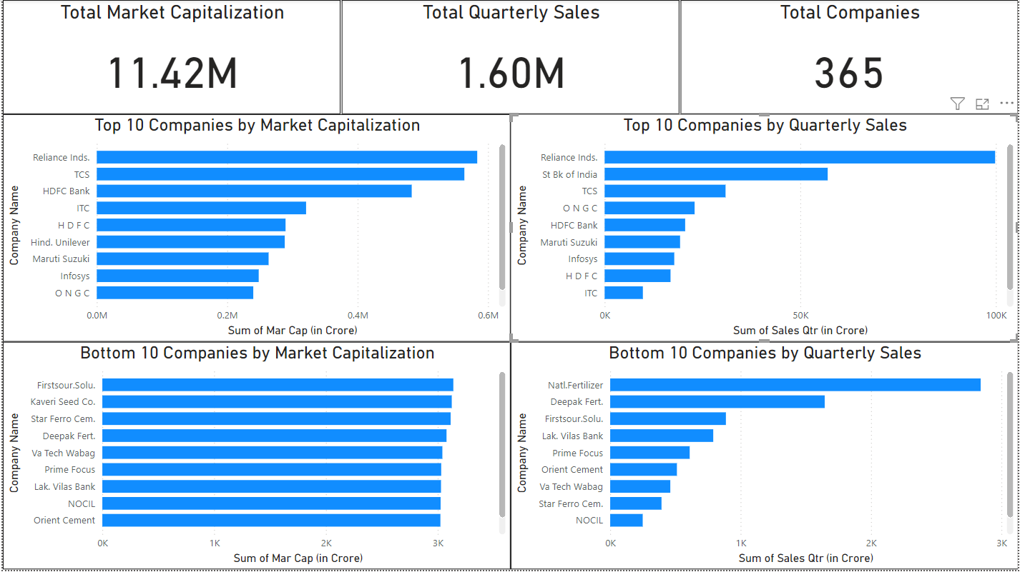
My Design

Slide 6
Thank you

